Slide 1
Airbnb Data Analysis and Price Prediction using ML
Submitted by:
Abhay Paunikar (Roll no. : )
Kaivalya Pande( Roll no. : 56547)
Guided by:
Mr. Girish Gaikwad
Sunbeam Institute Pvt. Ltd.

Slide 2

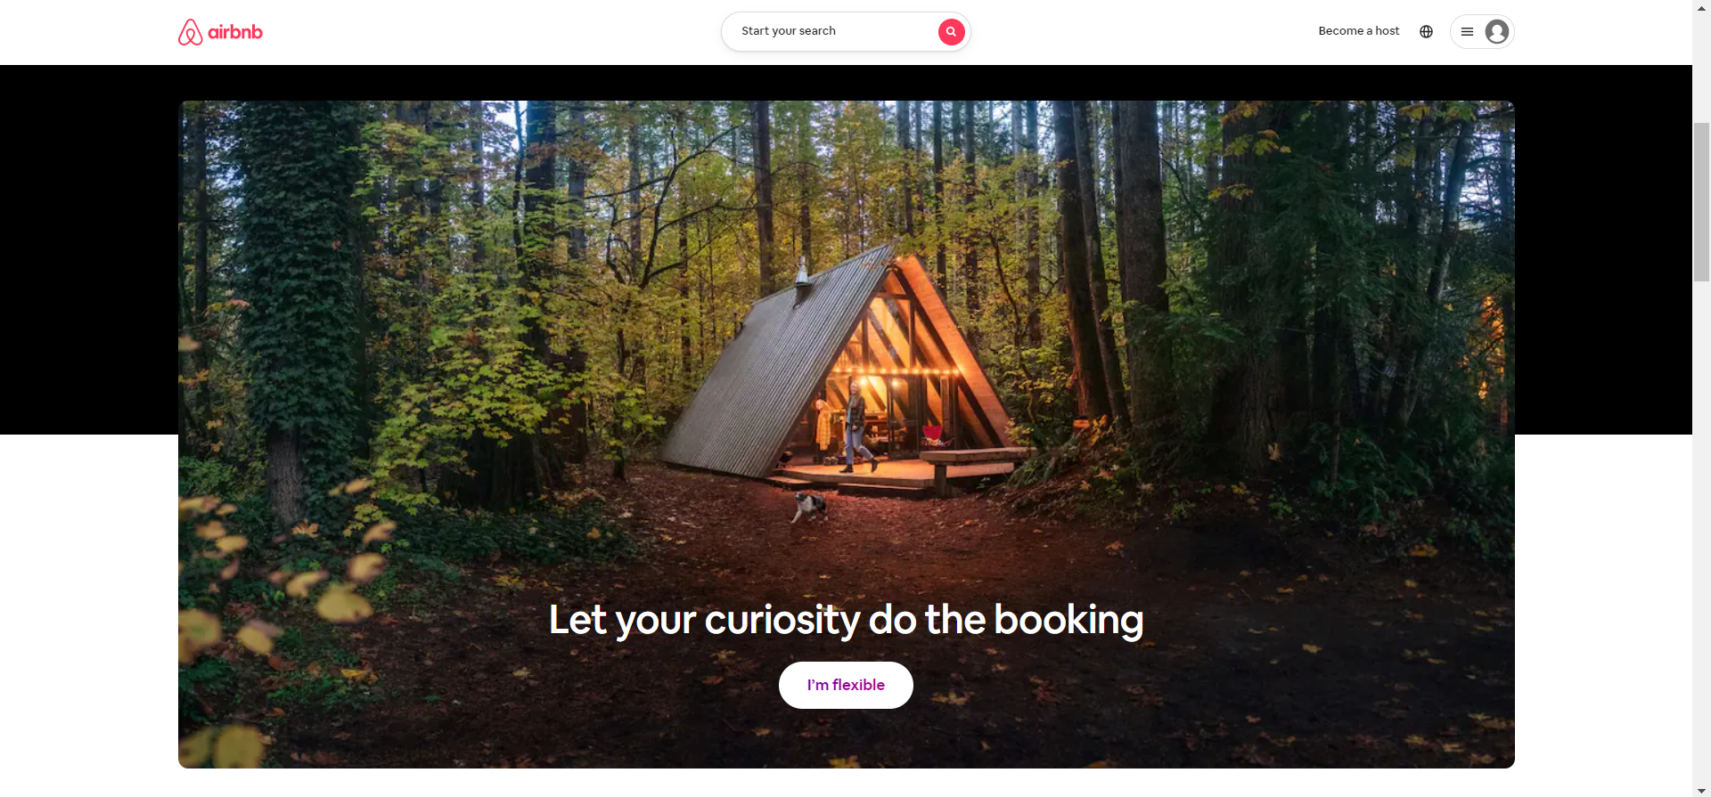
What is Airbnb?
A home-sharing utility started in 2008 by Brian Chesky and others
Platform for hosts and guests to deal
Huge variety of houses, apartments, holiday homes etc.

Slide 3


Biggest challenge faced by hosts:
As an Airbnb host, I want to know what price to advertise my property at, in order to maximize my income.
What can be Done?
Analysis of Airbnb data
Machine Learning and Deep Learning models for predicting prices

Slide 4
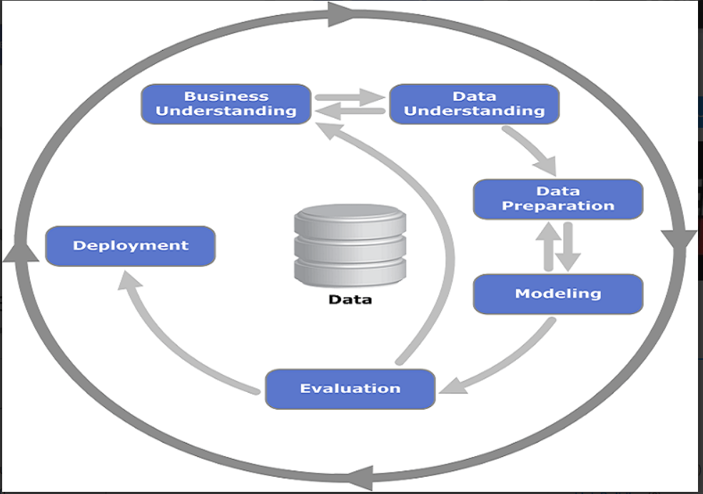
Approach followed:

Slide 5








Tools Used:

Slide 6

The data :
28
Id | accommodates | bathrooms | . . .
---- | ---- | ---- | ----
---- | ---- | ---- | ----
---- | ---- | ---- | ----
---- | ---- | ---- | ----
---- | ---- | ---- | ----
74111

Slide 7
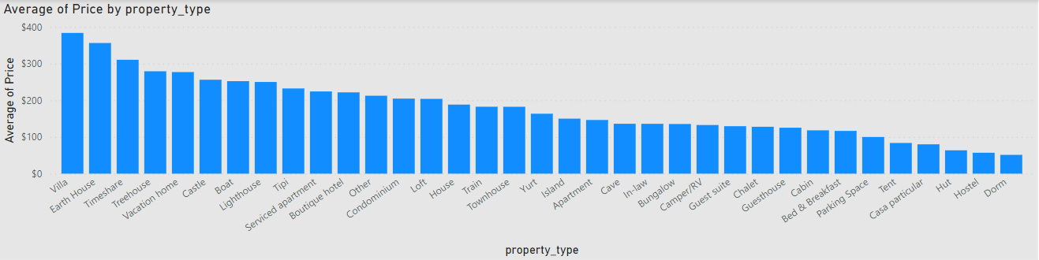
Exploratory Data Analysis:
Categorical Columns
property_type, city
Binary Columns
cleaning_fee
Numerical Columns
accommodates
review_scores_rating
room_type
bed_type
cancellation_policy
host_has_profile_pic
host_identity_verified
instant_bookable
bathrooms
bedrooms, beds
Date Columns
host_since
first_review
last_review
Average price by property type:

Slide 8
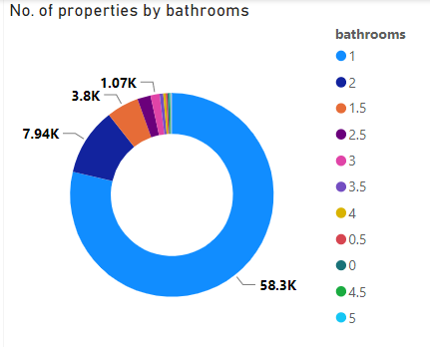
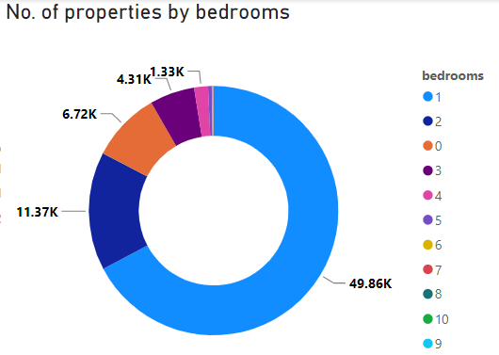
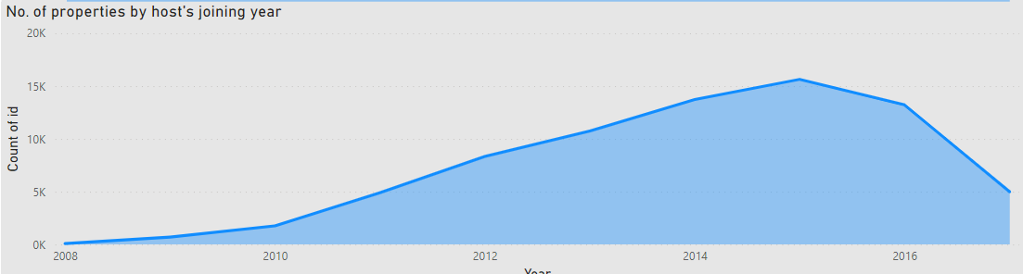
No. of listings by bathrooms:
No. of listings by bedrooms:
No. of listings through the years:

Slide 9
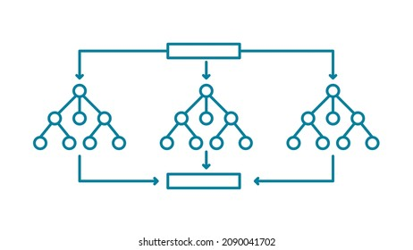
Machine Learning Algorithms Used:
Simple Linear Regression
Ridge and Lasso Regressions
K-Nearest Neighbors
Support Vector Machines
Random Forest
Finally Selected:
Random Forest
Hyperparameters:
n_estimators=750
min_samples_split=7
min_samples_leaf=8
max_features=40
max_depth=20
bootstrap=True

Slide 10
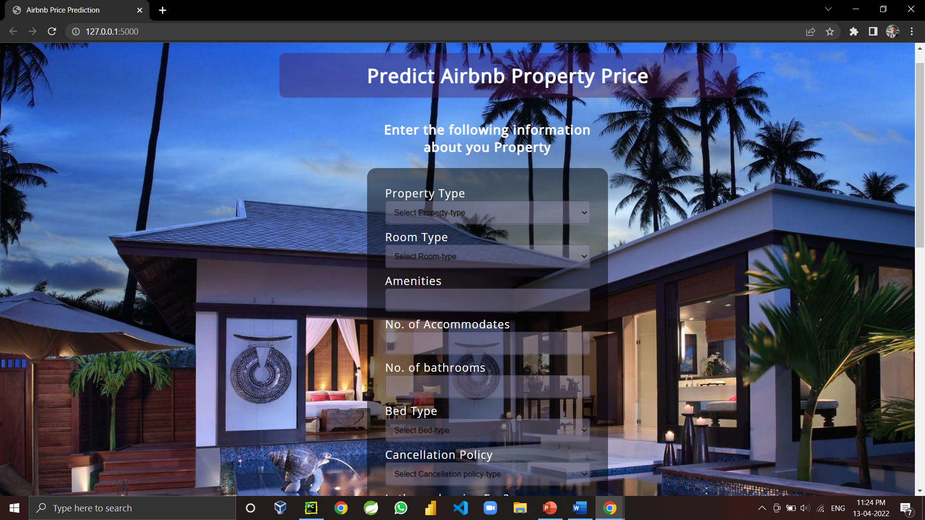
User Interface:

Slide 11
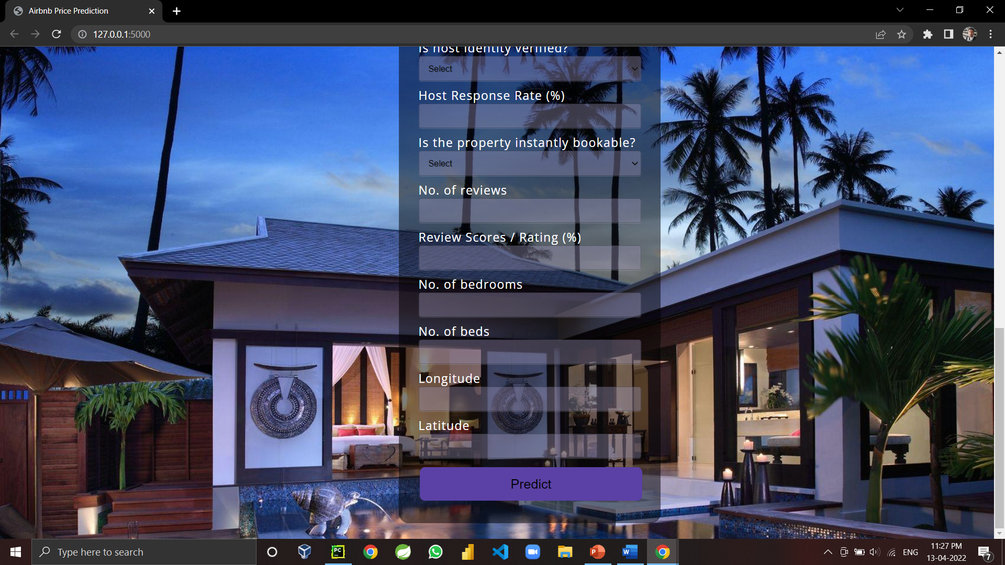
User Interface:

Slide 12

Scope for Future Work:

Slide 13
Thank You!!!!

